Slide 1
Understanding Join, Union & subqueries in SQL

Slide 2
We will cover the following
Inner Join or Join
Outer Join or Full Outer Join
Left Join or Left Outer Join
Right Join or Right Outer Join
Self Join
Display mismatch row using Left Join
Union vs Join
Union Vs Union all
Cross Join

Slide 3
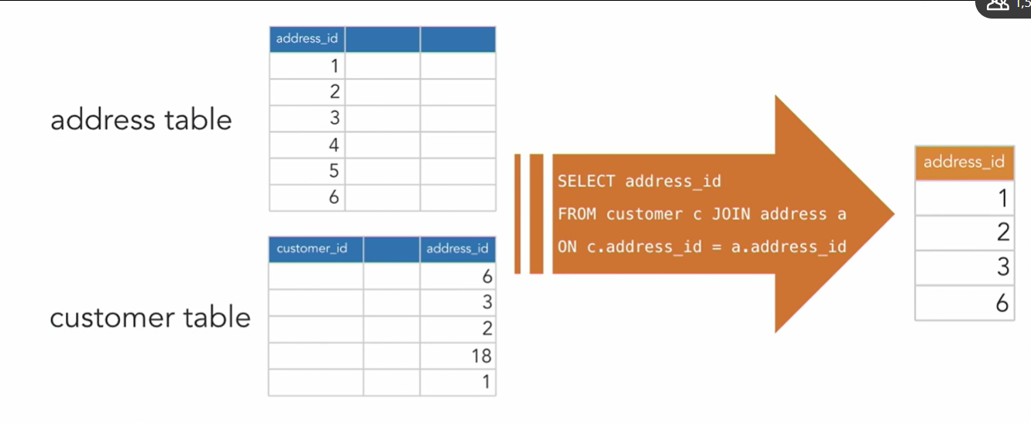
Inner Join: Returns matched row between tables

Slide 4
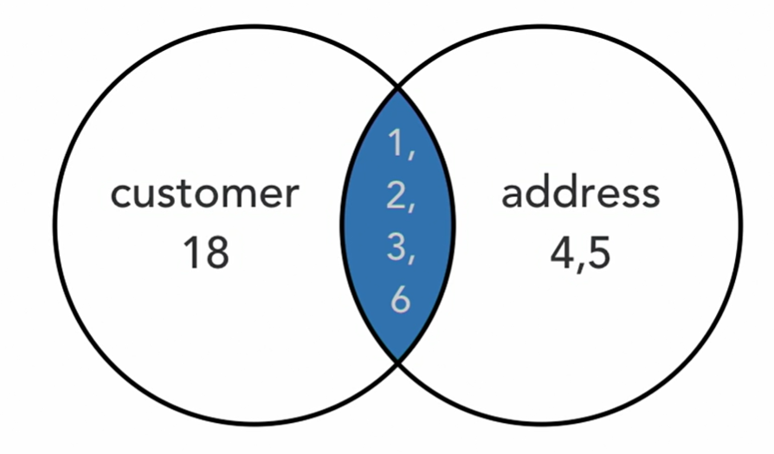
Inner Join or Join using Venn diagram

Slide 5

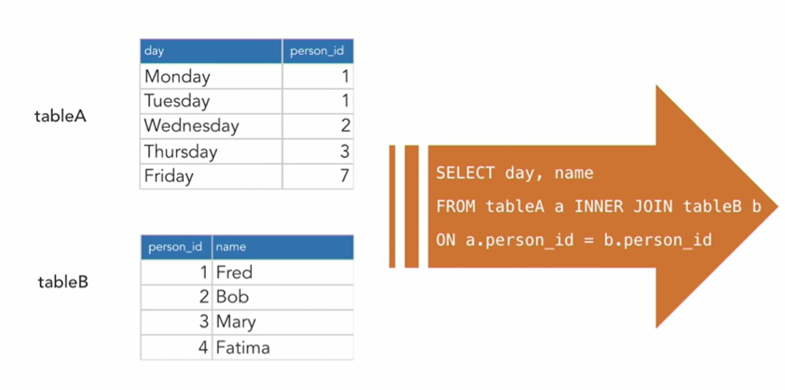
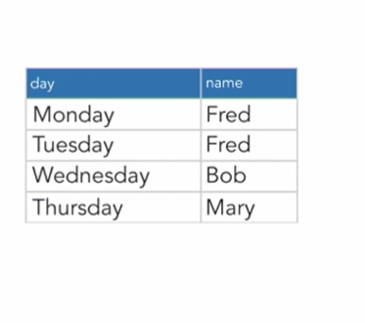
Inner Join or Join

Slide 6
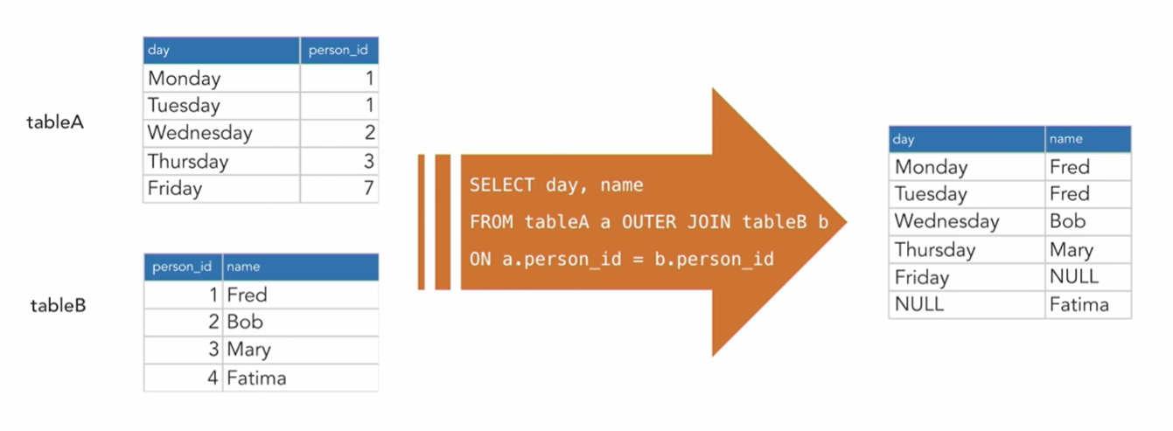
Full join or Outer join – Returns all rows, whether or not there is a match within tables

Slide 7
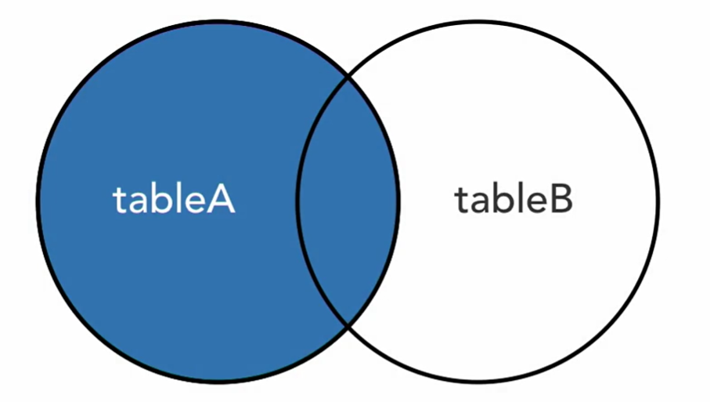
Left join or left outer join : Returns all records from the table to the left of the keyword “JOIN”.

Slide 8
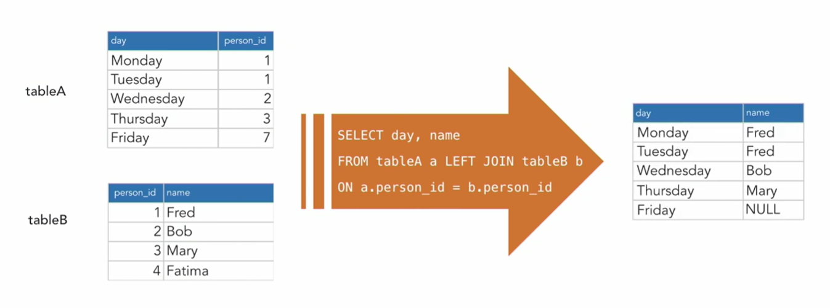
Left join or Left outer join

Slide 9
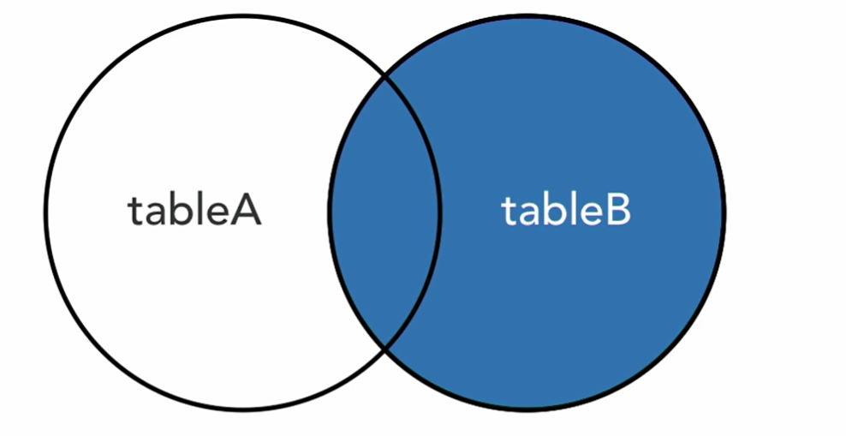
Right Join or Right Outer join

Slide 10
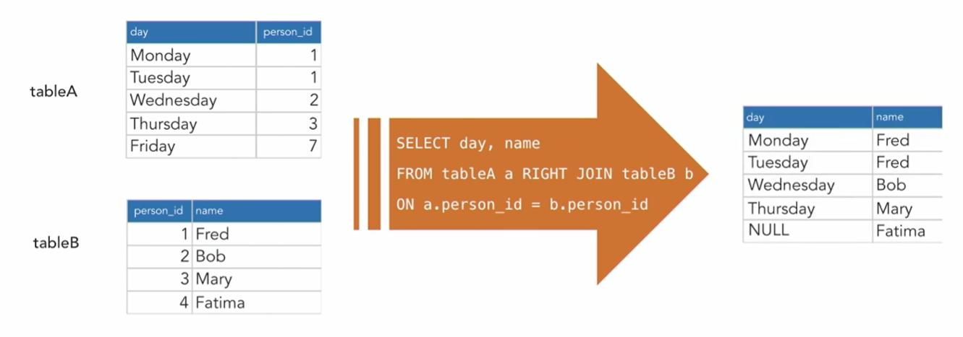
Right join or Right outer join : Returns all records from the table to the right of the keyword “JOIN”

Slide 11
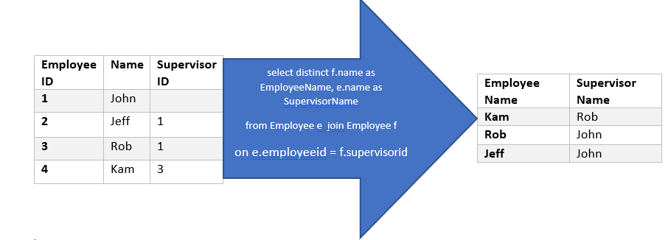
Self Join- Joining a table with itself

Slide 12
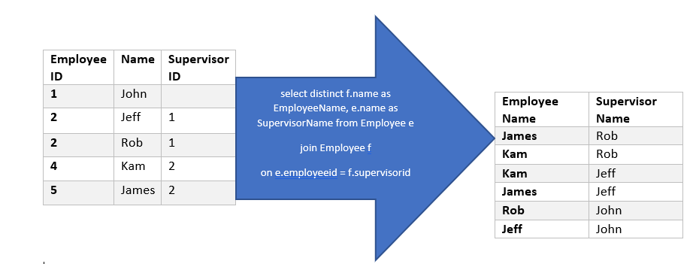
Cross Join- Returns Cartesian product between two tables

Slide 13
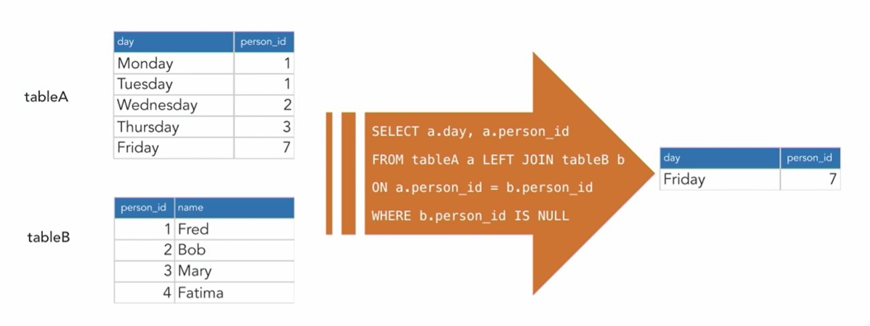
Display mismatch row using left join

Slide 14
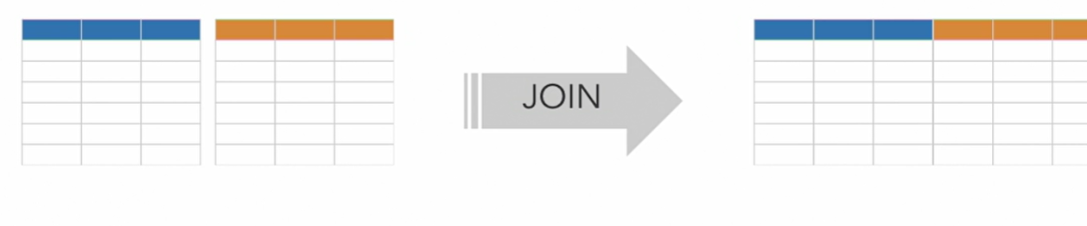
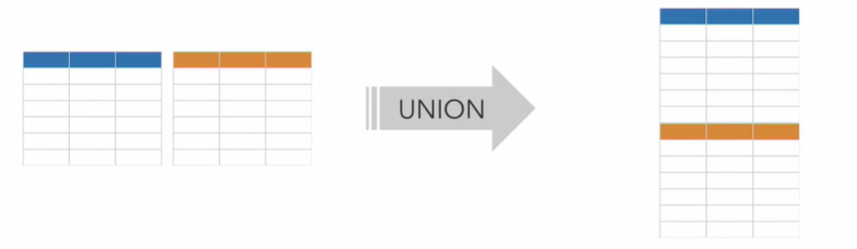
Join vs Unions
JOINs merge data horizontally. When we join 2 tables of three fields each, we get one table of 6 fields
Unions merges vertically. A union of the same two tables with 6 rows each gives us one table of three fields and 12 rows

